Slide 1
Searching a
BST

Slide 2
Searching Trees
To search a tree, you will use the same
basic logic that you used to add a new
node.
First, compare the current node to the
search value and see if it is a match. If
it is not a match, check to see if you
need to search the left sub tree or the
right sub tree. Repeat.
Sounds like a binary search.

Slide 3
Searching Trees
private boolean search(Comparable val, TreeNode tree)
{
if(tree != null)
{
int dirTest = val.compareTo(tree.getValue());
if(dirTest == 0 )
return true;
else if (dirTest < 0)
return search(val, tree.getLeft());
else if (dirTest > 0)
return search(val, tree.getRight());
}
return false;
}

Slide 4
Open
contains.java

Slide 5
Tree
Attributes

Slide 6
Tree Attributes
90
50
120
40
65
100
150
30
45
70
95
WIDTH - 7 HEIGHT - 3
NUMLEAVES - 5 NUMLEVELS - 4
NUMNODES - 11 ISFULL – NO

Slide 7
Binary Trees
Width - distance between two furthest leaves in the tree (does not have to go through the root!)
Height – longest path from root to a leaf
# of links from root to farthest leaf
Level = row = nodes with same height
the root is level - 0
the children of the root = level 1
Notes:
The definition given above for width is sometimes referred to as the diameter of a binary tree:
The diameter of a tree (sometimes called the width) is the number of nodes on the longest path between two leaves in the tree.
diameter (T) = max ( diameter(T->left), diameter(T->right) , 1 + height(T->left) + height(T->right) );
The width of a binary tree is the maximum number of elements on one level of the tree. Width(T) = maximum of nodes in a level
int GetDiameter(Node *n) { if(n == NULL) return -1; int leftDiameter = GetDiameter(n->left); int rightDiameter = GetDiameter(n->right); if(leftDiameter+rightDiameter+2 > max) max = leftDiameter+rightDiameter+2; if(leftDiameter > rightDiameter) return leftDiameter+1; return rightDiameter+1; }

Slide 8
Width
90
50
120
40
65
100
150
30
45
70
95
WIDTH - 7

Slide 9
Height
90
50
120
40
65
100
150
30
45
70
95
HEIGHT - 3
Notes:
The maximum distance of any node from the root. If a tree has only one node (the root), the height is zero. The height of an empty tree is not defined.

Slide 10
A Complete Tree
In a complete tree, every level that can
be filled is filled. Any levels that are not
full have all nodes shifted as far left
as possible.

Slide 11
A PROPER
BINARY TREE
A proper binary tree is strictly binary, i.e. every node has exactly two children or no children at all.
Equivalently: In a proper binary tree, every parent has exactly two children.
Notes:
Theorems: Let T be a nonempty, full binary tree. Then:
(a) If T has I internal nodes (i.e. parent nodes), the number of leaves is L = I + 1.
(b) If T has I internal nodes, the total number of nodes is N = 2I + 1.
(c) If T has a total of N nodes, the number of internal nodes is I = (N – 1)/2.
(d) If T has a total of N nodes, the number of leaves is L = (N + 1)/2.
(e) If T has L leaves, the total number of nodes is N = 2L – 1.
(f) If T has L leaves, the number of internal nodes is I = L – 1.

Slide 12
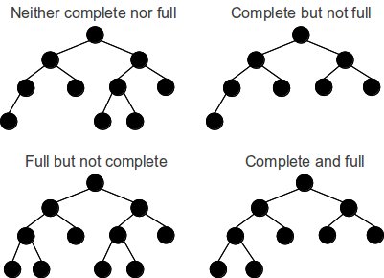
Neither complete nor proper
Complete but not proper
Proper but not complete
Both complete and proper

Slide 13
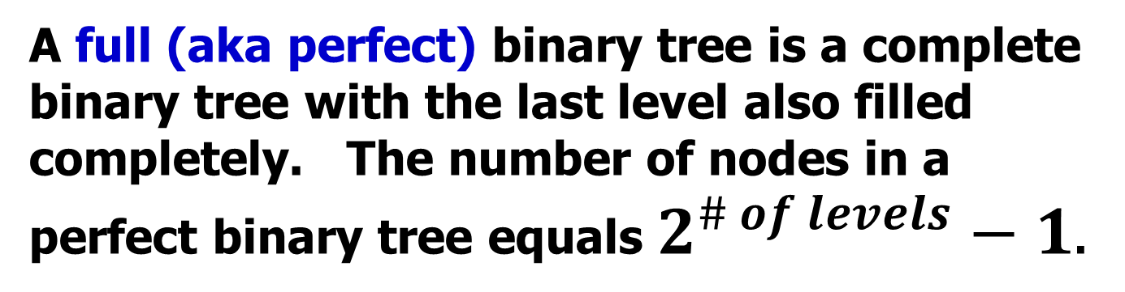
A Full / Perfect
BINARY TREE
A full (aka perfect) binary tree is a complete binary tree with the last level also filled completely. The number of nodes in a perfect binary tree equals $2^{\# of levels}−1$.
There are 7 nodes:
2^{(3 levels)} – 1 = 7

Slide 14
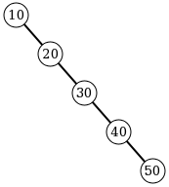
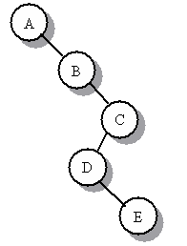
A degenerate binary tree
A tree where each parent node has only one associated child node. This means that performance-wise, the tree will behave like a linked list.

Slide 15
getNumLevels Algo
int getNumLevels(TreeNode tree)
{
if (tree==null)
return something;
else
{
numLeft = getNumLevels of the left
numRight = getNumLevels of the right
if (numLeft > numRight)
return 1 + numLeft;
else
return 1 + numRight;
}
}

Slide 16
getNumLevels Algo
public int getNumLevels()
{
return getNumLevels(root);
}
private int getNumLevels(TreeNode tree)
{
if(tree==null) return 0;
else {
return
1 + Math.max(getNumLevels(tree.getLeft() ,
getNumLevels(tree.getRight());
}
}

Slide 17
getNumLevels Algo
public int getNumLevels()
{
return getNumLevels(root);
}
private int getNumLevels(TreeNode tree)
{
if(tree==null) return 0;
else {
int numLeft = getNumLevels(tree.getLeft());
int numRight = getNumLevels(tree.getRight());
if(numLeft > numRight)
return 1 + numLeft;
return 1 + numRight;
}
}

Slide 18
Open
numlevels.java

Slide 19
BigO

Slide 20
Big-O Notation
Big-O notation is an assessment of an
algorithm’s efficiency. Big-O notation
helps gauge the amount of work that
is taking place.
Common Big O Notations :
O(1) O(Log₂N)
O(2^{N}) O(N²)
O(N Log₂N) O(N)
O(Log₂N) O(N³)

Slide 21
Binary Search Tree
Average case = these results assume the tree is balanced or near balanced.
traverse all nodes O(N)
search for an item O(log₂N)
remove any item O(log₂N) location unknown
get any item O(log₂N) location unknown
add item at the end O(log₂N)
add item at the front O(1)
Notes:
A balanced binary tree is commonly defined as a binary tree in which the depth of the two subtrees of every node never differ by more than 1,^{[3]} although in general it is a binary tree where no leaf is much farther away from the root than any other leaf. (Different balancing schemes allow different definitions of "much farther"^{[4]}). Binary trees that are balanced according to this definition have a predictable depth (how many nodes are traversed from the root to a leaf, root counting as node 0 and subsequent as 1, 2, ..., depth). This depth is equal to the integer part of where is the number of nodes on the balanced tree. Example 1: balanced tree with 1 node, (depth = 0). Example 2: balanced tree with 3 nodes, (depth=1). Example 3: balanced tree with 5 nodes, (depth of tree is 2 nodes).

Slide 22
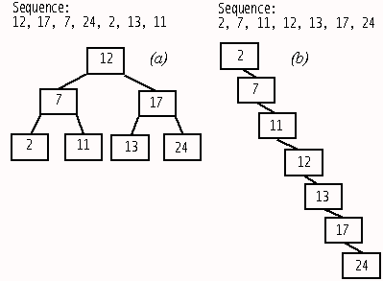
Average case: Balanced Tree (more or less)
Worst case: Data entered in natural order

